Slide 1

Data Resilience Strategies
15-slide presentation covering essential concepts, frameworks, and implementation approaches for data protection and recovery in business continuity planning.
This session explores how organizations protect and recover data as part of business continuity. Learners will examine strategic approaches, architecture options, and governance considerations that ensure data integrity and resilience.
Learning Objectives
Importance of data resilience
Relationship between resilience and recovery
Frameworks and governance alignment
Prepare for DRI International certifications
Notes:
Data resilience protects information availability, integrity, and recoverability
Supports business continuity and operational readiness
Ensures rapid restoration after disruptions
Reduces financial and operational impact
Enables strategic alignment across teams Example: A hospital protects patient data to keep services running during outages. Cyber example: A company uses redundant storage to continue operations during cyber incidents.

Slide 2
CLASS AGENDA
CLASS OBJECTIVES
Understanding data resilience principles
Core components and frameworks
Architecture and strategy design
Testing and improvement methods
Define data resilience and its purpose
Explain strategic data protection layers
Align data resilience with continuity planning
Understand how data resilience marries cybersecurity and business continuity

Slide 3

Why Data Resilience Matters
Financial Impact: Data disruptions cause significant financial losses through downtime and recovery costs.
Operational Continuity: Strong data resilience reduces downtime and ensures continuous business operations.
Business Dependency: Modern enterprises depend on data for every critical function and decision.
Competitive Advantage: Organizations with robust data resilience outperform competitors during crises.
Data resilience is no longer optional—it's a strategic imperative for organizational survival and growth.
Notes:
Data loss causes major financial risk
Disruptions impact operational continuity
Modern business depends heavily on data
Strong resilience improves competitiveness
Required for long-term growth preparedness Example: A bank avoids downtime losses with strong data protection. Cyber example: Ransomware impact minimized through resilient backup strategy.

Slide 4
Core Principles of Data Resilience
Foundational principles that guide effective data resilience strategies:
Availability
Integrity
Ensuring data and systems remain accessible when needed
Maintaining data accuracy and consistency throughout its lifecycle
Recoverability
Governance
Ability to restore data and operations after disruption
Clear accountability and policy-driven protection measures
Notes:
Definitions: Availability = access when needed Integrity = accuracy and consistency
Availability ensures reliable data access
Integrity maintains trustworthy information
Recoverability ensures restoration after incidents
Governance enforces accountability and controls
Principles support complete resilience lifecycle Example: Retailer restores accurate sales data after system crash. Cyber example: Integrity checks detect corruption from malware.

Slide 5

Data Resilience vs. Data Recovery
Data Resilience
Proactive: ensures continuity through prevention, redundancy, and preparedness measures.
Data Recovery
Reactive: focuses on post-incident restoration of data and systems to operational state.
Both are complementary elements of comprehensive data resilience architecture. Resilience minimizes disruption, while recovery ensures restoration.
Notes:
Resilience focuses on prevention and preparedness
Recovery focuses on post-incident restoration
Both complement each other
Resilience minimizes disruption impact
Recovery ensures full restoration capability Example: Manufacturer uses redundancy to avoid downtime, then restores lost data. Cyber example: After cyberattack, systems failover automatically while backups restore data.

Slide 6
Layers of Data Resilience
Comprehensive data resilience requires protection across multiple interconnected layers:
Infrastructure Resilience
Application Resilience
Redundant servers, networks, and storage systems that maintain operations during hardware failures.
Software systems designed to handle failures gracefully and maintain functionality.
Information Resilience
Governance Resilience
Data protection through backups, replication, encryption, and validation processes.
Policies, controls, and accountability frameworks that ensure consistent protection.
Notes:
Infrastructure layer prevents system-level failures
Application layer maintains functional continuity
Information layer protects data fully
Governance layer defines oversight controls
Combined layers enable end-to-end resilience Example: Company uses redundant servers and frequent backups. Cyber example: Cloud system replicates data across regions for resilience.

Slide 7

Frameworks Supporting Data Resilience
Industry frameworks provide structured approaches to implementing data resilience:
ISO 27001: Information Security Management Systems with comprehensive data protection controls
ISO 22301: Business Continuity Management ensuring operational resilience
NIST SP 800-34: Contingency Planning Guide for Federal Information Systems
DRI Standards: Professional practices for business continuity and disaster recovery
Framework alignment ensures consistency, audit readiness, and integration with organizational governance structures.
Notes:
ISO 27001 ensures secure information management
ISO 22301 defines continuity structure
NIST SP 800-34 guides system contingency
DRI practices integrate resilience standards
Frameworks support audit readiness Example: Firm aligns backup controls to ISO requirements. Cyber example: Security team uses NIST guidance for recovery planning.

Slide 8
Data Protection Strategies
Effective data protection requires multiple coordinated strategies:
Backup & Snapshots
Replication
Regular automated backups with point-in-time recovery capabilities and offsite storage.
Real-time or near-real-time data replication across regions or cloud providers.
Encryption
Access Control
Data protection in transit and at rest using strong encryption algorithms and key management.
Role-based access controls and identity management ensuring only authorized data access.
Notes:
Replication = real-time data copying
Backups ensure point-in-time recovery
Replication protects against regional failures
Encryption secures data confidentiality
Access control prevents unauthorized use
Strategies require combined implementation Example: Company stores offsite backups in secure locations. Cyber example: Zero-trust access limits breach impact on data.

Slide 9
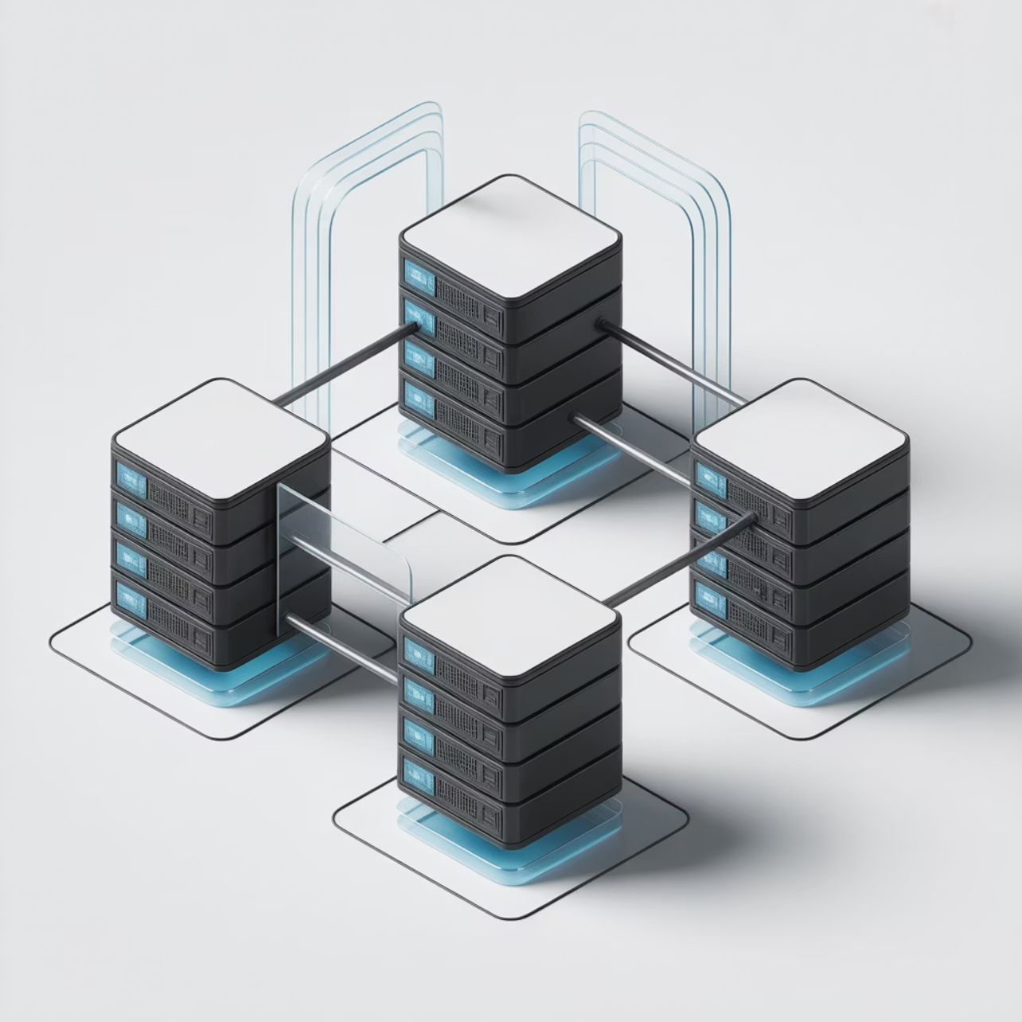
Designing for High Availability
High availability (HA) ensures services remain operational during disruptions through strategic design choices:
Clustering: Multiple servers working together to provide seamless failover capabilities
Load Balancing: Traffic distribution across multiple systems to prevent overload
Geographic Redundancy: Distributed infrastructure across multiple locations
Automated Failover: Systems that automatically switch to backup resources
Effective HA design balances performance requirements with cost considerations and operational complexity.
Notes:
Clustering prevents single points of failure
Load balancing distributes system demand
Geographic redundancy protects regional operations
Automated failover ensures rapid continuity
HA design requires cost-performance balance Example: E-commerce site uses load balancing to avoid service crashes. Cyber example: System automatically fails over during cyber disruption.

Slide 10
Recovery Objectives and Metrics
Define measurable goals for data continuity and establish clear performance indicators:
Recovery Time Objective (RTO)
Recovery Point Objective (RPO)
Mean Time to Recovery (MTTR)
Maximum acceptable downtime before systems must be restored to operation.
Maximum acceptable data loss measured in time since last backup or replication.
Average time required to restore systems and data after an incident occurs.
Establish KPIs to track resilience maturity, including backup success rates, test completion, and incident response times.
Notes:
RTO = maximum acceptable downtime RPO = maximum acceptable data loss
Define RTO for recovery speed
Define RPO for data tolerance
Track MTTR performance
Measure backup success rates
Use KPIs to monitor maturity Example: Company sets 2-hour RTO for operations. Cyber example: Database replication meets 15-minute RPO requirement.

Slide 11

Cloud and Hybrid Resilience
Modern cloud platforms introduce new opportunities and challenges for data resilience:
Cloud Flexibility: Rapid scaling and geographic distribution of resources for enhanced resilience
Multi-Region Replication: Automatic data replication across cloud regions for disaster recovery
Hybrid Models: Combining on-premise and cloud resources for optimal control and performance
Vendor Management: Understanding shared responsibility models and cloud provider capabilities
Hybrid architectures enable organizations to balance control, performance, compliance, and cost considerations.
Notes:
Cloud enables flexible scaling
Multi-region replication improves redundancy
Hybrid models balance control and efficiency
Shared responsibility requires vendor awareness
Governance must match architecture complexity Example: Business uses hybrid model for compliance and performance. Cyber example: Cloud provider replicates data across regions automatically.

Slide 12
Testing and Continuous Improvement
Regular testing validates resilience effectiveness and identifies areas for enhancement:
1
2
Recovery Simulations
Data Integrity Checks
Conduct realistic disaster scenarios to test recovery procedures and timing.
Verify backup completeness and data quality through automated validation.
3
4
Access Validation
Document & Refine
Test authentication systems and access controls under various scenarios.
Record results, identify gaps, and continuously improve processes and procedures.
Notes:
Simulations validate recovery workflows
Integrity checks confirm data accuracy
Access validation tests authentication
Documentation drives improvement cycles
Regular testing increases reliability Example: Company tests disaster scenario annually. Cyber example: Team verifies access controls under simulated attack.

Slide 13

Common Challenges in Data Resilience
Organizations frequently encounter specific obstacles when implementing data resilience strategies:
Governance Coordination: Lack of clear ownership and cross-functional collaboration between IT, security, and business units
Testing Gaps: Inconsistent testing schedules, outdated backup procedures, or incomplete recovery validation
Vendor Dependencies: Over-reliance on single providers and inadequate understanding of shared responsibilities
Cost Constraints: Balancing resilience investments with budget limitations and ROI requirements
Skills Shortage: Limited expertise in emerging technologies and complex hybrid environments
Notes:
Weak governance coordination limits effectiveness
Testing inconsistencies reduce readiness
Vendor dependency increases exposure
Budget constraints restrict controls
Skills gaps slow implementation Example: Organization struggles maintaining consistent backup tests. Cyber example: IT misconfigures cloud backups due to skill shortages.

Slide 14


Aligning Data Resilience with Governance
Governance ensures accountability, compliance, and strategic alignment of data resilience efforts:
Policy Integration: Embed data resilience requirements into organizational policies and procedures
Risk Assessment: Regular evaluation of data risks and resilience capabilities as part of enterprise risk management
Compliance Mapping: Align data protection controls with regulatory requirements and industry standards
Audit Readiness: Maintain documentation and evidence to support internal and external audits
Executive Oversight: Board-level reporting on data resilience maturity and investment priorities
Example: Mapping ISO 27001 controls to organizational data protection procedures ensures consistent implementation and audit trail.
Notes:
Embed requirements into formal policies
Conduct regular risk assessments
Align controls with compliance standards
Maintain audit documentation
Ensure executive oversight and reporting Example: Leadership reviews resilience indicators quarterly. Cyber example: Security maps ISO controls to cyber recovery steps.

Slide 15

Summary and Key Takeaways
Strategic Foundation: Data resilience underpins all business continuity strategies and requires proactive investment in prevention and preparedness.
Layered Protection: Effective resilience addresses infrastructure, applications, data, and governance through coordinated strategies.
Framework Integration: Industry frameworks like ISO standards and DRI practices provide structured approaches to implementation.
Testing Excellence: Regular validation through simulations and audits ensures resilience capabilities meet organizational needs.
Governance Alignment: Strong governance ensures accountability, compliance, and continuous improvement in resilience maturity.
Remember: Data resilience creates organizational strength and enables recovery readiness for sustained business continuity.
Notes:
Data resilience forms continuity foundation
Layered protection addresses full lifecycle
Frameworks guide structured implementation
Testing validates readiness and capability
Governance ensures accountability and improvement Example: Business updates data protection roadmap annually. Cyber example: Cyber team revises backup schedule after threat changes.

Slide 16
BREAK TIME
Be back in 15 mins.
Notes:
https://www.ncsc.gov.uk/static-assets/documents/PwnedPasswordsTop100k.txt

Slide 17

Cyber Resilience Strategies
Data & Cyber Resilience Module - DRI International Certification Preparation
This session explores how organizations prepare for, withstand, and recover from cyber incidents. Learners will examine strategies that integrate cybersecurity, IT continuity, and governance into a unified cyber resilience framework designed to protect organizational assets and enable rapid recovery.
Key Focus Areas
Understanding cyber resilience fundamentals
Key frameworks and controls integration
Integration with business continuity planning
Testing and maturity measurement
Notes:
Cyber resilience integrates security with continuity
Protects operations from cyber disruption
Focuses on prevention, detection, response, recovery
Strengthens operational performance under attack
Supports DRI certification readiness Example: Company maintains operations during a major cyber event. Cyber example: SOC coordinates response and recovery to minimize downtime.

Slide 18
CLASS AGENDA
CLASS OBJECTIVES
The evolution of cyber resilience
Core principles and frameworks
Cyber incident response and recovery
Testing, measurement, and continuous improvement
Define cyber resilience and its business value proposition
Identify the critical link between cybersecurity and continuity
Apply cyber resilience practices aligned to DRI frameworks
Develop comprehensive testing and measurement strategies

Slide 19
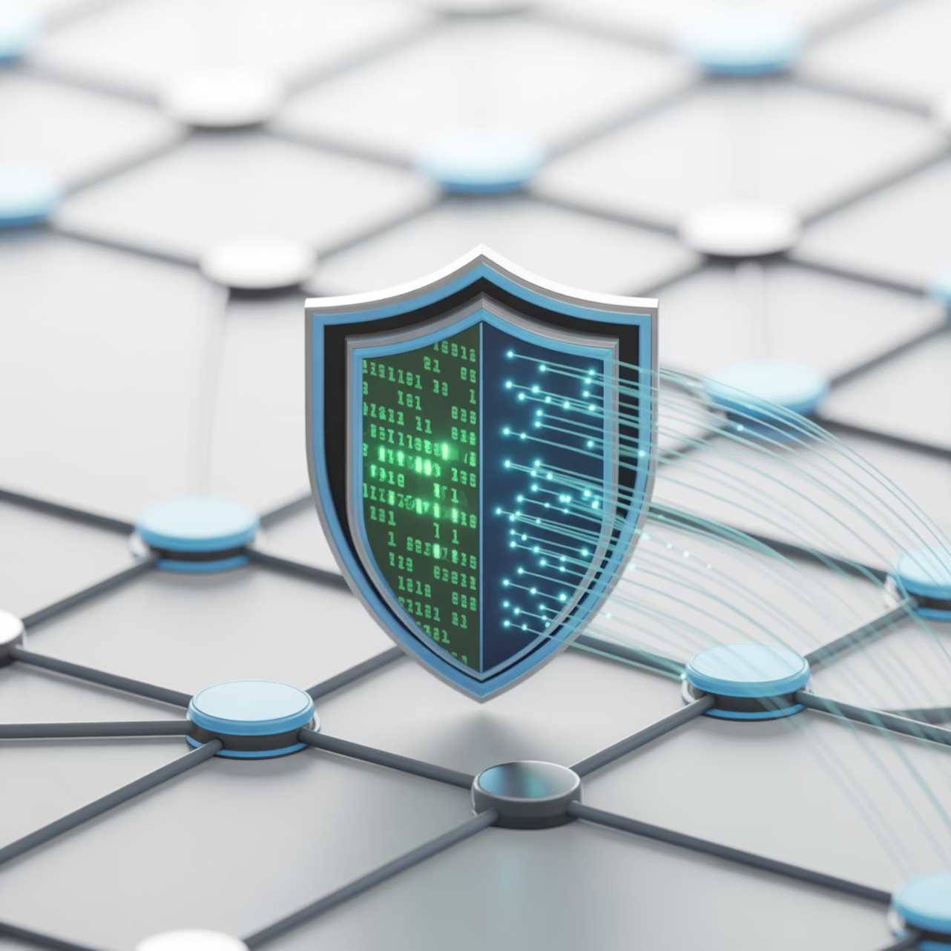
What Is Cyber Resilience?
Cyber resilience combines proactive cybersecurity measures with adaptive business continuity strategies. It represents an organization's ability to deliver continuous operations during and after cyberattacks.
Proactive Defense: Anticipating and preventing cyber threats before they impact operations
Operational Continuity: Maintaining critical business functions during security incidents
Adaptive Recovery: Rapidly restoring full capability while improving future resilience
Strategic Integration: Aligning cyber risk management with enterprise objectives
Goes beyond traditional protection — emphasizes sustained performance and strategic recovery capabilities.
Notes:
Combines cybersecurity, continuity, and adaptive recovery
Ensures operations continue during cyber attacks
Uses proactive defense measures
Enables rapid restoration after incidents
Aligns with business strategy Example: Factory keeps production running during attack. Cyber example: Automated tools detect and contain intrusion quickly.

Slide 20

Why Cyber Resilience Matters
Cyber threats now represent a primary organizational risk, requiring comprehensive strategic approaches that extend beyond traditional security measures.
Business Impact: Cyber incidents can halt operations, damage reputation, and create regulatory exposure
Traditional Limitations: Security alone cannot guarantee uptime, data integrity, or stakeholder confidence
Strategic Advantage: Resilience builds organizational agility and competitive differentiation
Regulatory Compliance: Growing requirements for cyber resilience planning and reporting
Stakeholder Confidence: Demonstrable resilience capabilities enhance investor and customer trust
Organizations with mature cyber resilience programs experience faster recovery times and reduced business impact from security incidents.
Notes:
Cyber threats cause major disruptions
Traditional security alone is insufficient
Resilience creates competitive advantage
Regulations require cyber readiness
Stakeholders expect operational continuity Example: Outage damages company reputation after breach. Cyber example: Regulators demand documented cyber recovery plans.

Slide 21
Core Components of Cyber Resilience
Comprehensive cyber resilience encompasses integrated capabilities across prevention, detection, response, and recovery domains.
Threat Prevention
Detection & Monitoring
Proactive security controls and risk mitigation measures
Continuous surveillance and threat intelligence capabilities
Response Planning
Recovery Operations
Coordinated incident response and containment procedures
Systematic restoration and business continuity processes
These components work synergistically to create comprehensive organizational protection and operational sustainability during cyber incidents.
Notes:
Prevention reduces threat exposure
Detection identifies incidents quickly
Response plans contain damage
Recovery restores operations efficiently
Components work together for resilience Example: Business limits impact through early threat detection. Cyber example: Automated alerts trigger rapid response actions.

Slide 22
Frameworks and Standards Supporting Cyber Resilience
Industry standards provide structured approaches for developing and measuring cyber resilience capabilities across organizational contexts.
NIST Cybersecurity Framework (CSF) 2.0
ISO 27001 and ISO 22301
DRI Professional Practices
Information security management systems integrated with business continuity standards
Business continuity methodologies adapted for cyber resilience integration
Six core functions: Govern, Identify, Protect, Detect, Respond, and Recover, with enhanced governance focus
Framework integration improves alignment with standards including CIS Controls, ISO 27001, and NIST 800-53, enhancing organizational maturity, auditability, and interoperability across security domains.
Notes:
NIST CSF defines governance-to-recovery lifecycle
ISO 27001 integrates security controls
ISO 22301 supports continuity alignment
DRI standards guide organizational resilience
Frameworks build audit-ready maturity Example: Organization uses ISO to validate program structure. Cyber example: Security aligns operations with NIST CSF 2.0.

Slide 23

Integrating Cybersecurity and Business Continuity
Successful cyber resilience requires seamless integration between cybersecurity protective measures and business continuity operational capabilities.
Complementary Functions: Cybersecurity protects data integrity and system availability; continuity ensures sustained operations during disruptions
Coordinated Response: Integration enables synchronized threat detection, incident response, and recovery activities
Unified Governance: Shared processes and cross-functional teams improve situational awareness and decision-making
Resource Optimization: Combined planning reduces duplication and maximizes investment efficiency
Strategic Alignment: Integrated approach ensures cyber resilience supports broader organizational objectives
Organizations achieve greater effectiveness when cyber and continuity capabilities are designed, implemented, and managed as unified systems rather than separate functions.
Notes:
Cybersecurity protects systems and data
Continuity maintains operations during incidents
Integration enables coordinated response
Shared governance improves awareness
Minimizes duplicated effort across teams Example: Organization combines cyber and continuity teams. Cyber example: Joint playbooks define shared responsibilities.

Slide 24
Cyber Incident Response Strategies
Resilient organizations implement comprehensive incident response capabilities that minimize disruption while ensuring effective containment and recovery.
1
2
Rapid Detection
Swift Containment
Automated monitoring systems identify anomalies and potential threats in real-time
Immediate isolation procedures prevent lateral movement and limit damage scope
3
4
Damage Assessment
Coordinated Recovery
Comprehensive impact analysis guides prioritized response and recovery decisions
Systematic restoration activities maintain business operations with minimal disruption
Critical success factors include cross-functional collaboration between IT, security, and business units, along with pre-established communication protocols and decision-making authorities.
Notes:
Rapid detection shortens incident duration
Swift containment limits attack spread
Impact assessment guides decisions
Coordinated recovery restores services
Cross-functional teamwork required Example: Company isolates compromised machines immediately. Cyber example: SOC uses containment tools to block lateral movement.

Slide 25
Data Protection in Cyber Resilience
Comprehensive data protection strategies form the foundation of effective cyber resilience, ensuring information confidentiality, integrity, and availability during security incidents.
Encryption Standards
Access Controls
End-to-end encryption for critical assets both in transit and at rest, with robust key management procedures
Network segmentation and zero-trust architecture limiting lateral movement during breaches
These protection strategies balance the CIA triad (Confidentiality, Integrity, Availability) while supporting business continuity requirements. Regular validation of backup systems and restoration procedures ensures recovery capabilities remain operational when needed.
Notes:
Encryption protects confidentiality
Access controls limit unauthorized access
Supports CIA triad requirements
Backup validation ensures recoverability
Zero-trust strengthens control posture Example: Firm encrypts sensitive data to avoid exposure. Cyber example: Segmented network prevents attacker movement.

Slide 26
Cyber Resilience Architecture
Robust architectural design integrates security, redundancy, and operational continuity requirements to support comprehensive cyber resilience capabilities.
Redundant Infrastructure
Automated Failover
Geographically distributed systems and networks eliminating single points of failure
Seamless switching capabilities maintaining operations during system compromises
Vulnerability Management
Scalability Planning
Continuous assessment and remediation processes reducing attack surface exposure
Architecture design supporting growth while maintaining security and resilience standards
Architecture decisions must align with organizational risk tolerance levels and recovery time objectives, balancing security requirements with operational efficiency and cost considerations.
Notes:
Redundant systems protect availability
Automated failover ensures continuity
Vulnerability management reduces risk
Scalable design supports future growth
Architecture aligns with risk tolerance Example: Company builds redundancy into core systems. Cyber example: Cloud environment uses multi-region failover.

Slide 27

Role of Leadership and Governance
Cybersecurity governance emphasizes that cybersecurity is a major source of enterprise risk that senior leaders should consider alongside others such as finance and reputation.
Executive Accountability: CSF 2.0 reinforces leadership accountability for risk through defined governance structures and oversight responsibilities
Strategic Integration: Cybersecurity is integrated into broader enterprise risk management strategy with dedicated accountability
Resource Alignment: Leadership commitment ensures appropriate investment in cyber resilience capabilities and infrastructure
Policy Consistency: Governance frameworks drive standardized approaches across organizational units and functions
Maturity Advancement: Sustained executive support improves organizational cyber resilience maturity over time
Governance aligns to a broader paradigm shift where cybersecurity becomes highly relevant within business context as operational risk.
Notes:
Executives accountable for cyber risk
Governance drives standardization
Strategies integrate with enterprise risk
Leadership enables investment decisions
Oversight raises maturity levels Example: Board reviews cyber updates quarterly. Cyber example: Leadership funds advanced monitoring tools.

Slide 28




Testing and Continuous Improvement
Regular validation through comprehensive testing programs ensures cyber resilience capabilities remain effective against evolving threat landscapes and organizational changes.
Tabletop Exercises
Red Team Testing
Scenario-based discussions testing decision-making and coordination
Adversarial simulations identifying vulnerabilities and response gaps
Recovery Drills
Lessons Integration
Full-scale restoration exercises validating technical and procedural capabilities
Quarterly plan updates incorporating testing outcomes and threat intelligence
Testing programs should include cross-functional participation, realistic scenario development, and systematic documentation of findings for continuous improvement initiatives.
Notes:
Tabletop tests assess coordination
Red team tests identify weaknesses
Recovery drills validate operational readiness
Lessons integrated into updates
Testing must be ongoing Example: Staff practice coordinated decision-making. Cyber example: Red team uncovers vulnerability for remediation.

Slide 29
Common Challenges in Cyber Resilience
Organizations frequently encounter obstacles that limit cyber resilience effectiveness, requiring strategic approaches to overcome implementation barriers.
Organizational Silos
Technology Focus
Disconnected security and continuity teams operating with limited coordination and communication
Over-reliance on technical solutions without adequate process, training, and governance components
Measurement Gaps
Resource Constraints
Lack of comprehensive metrics or maturity benchmarks for assessing resilience effectiveness
Insufficient budget allocation or skilled personnel for comprehensive resilience programs
Addressing these challenges requires executive sponsorship, cross-functional integration, and systematic capability development aligned with organizational risk tolerance and strategic objectives.
Notes:
Siloed teams slow response
Over-focus on tools reduces maturity
Weak measurement limits visibility
Resource constraints hinder readiness
Requires strategic alignment Example: Misaligned teams delay recovery choices. Cyber example: Lack of metrics hides real cyber gaps.

Slide 30
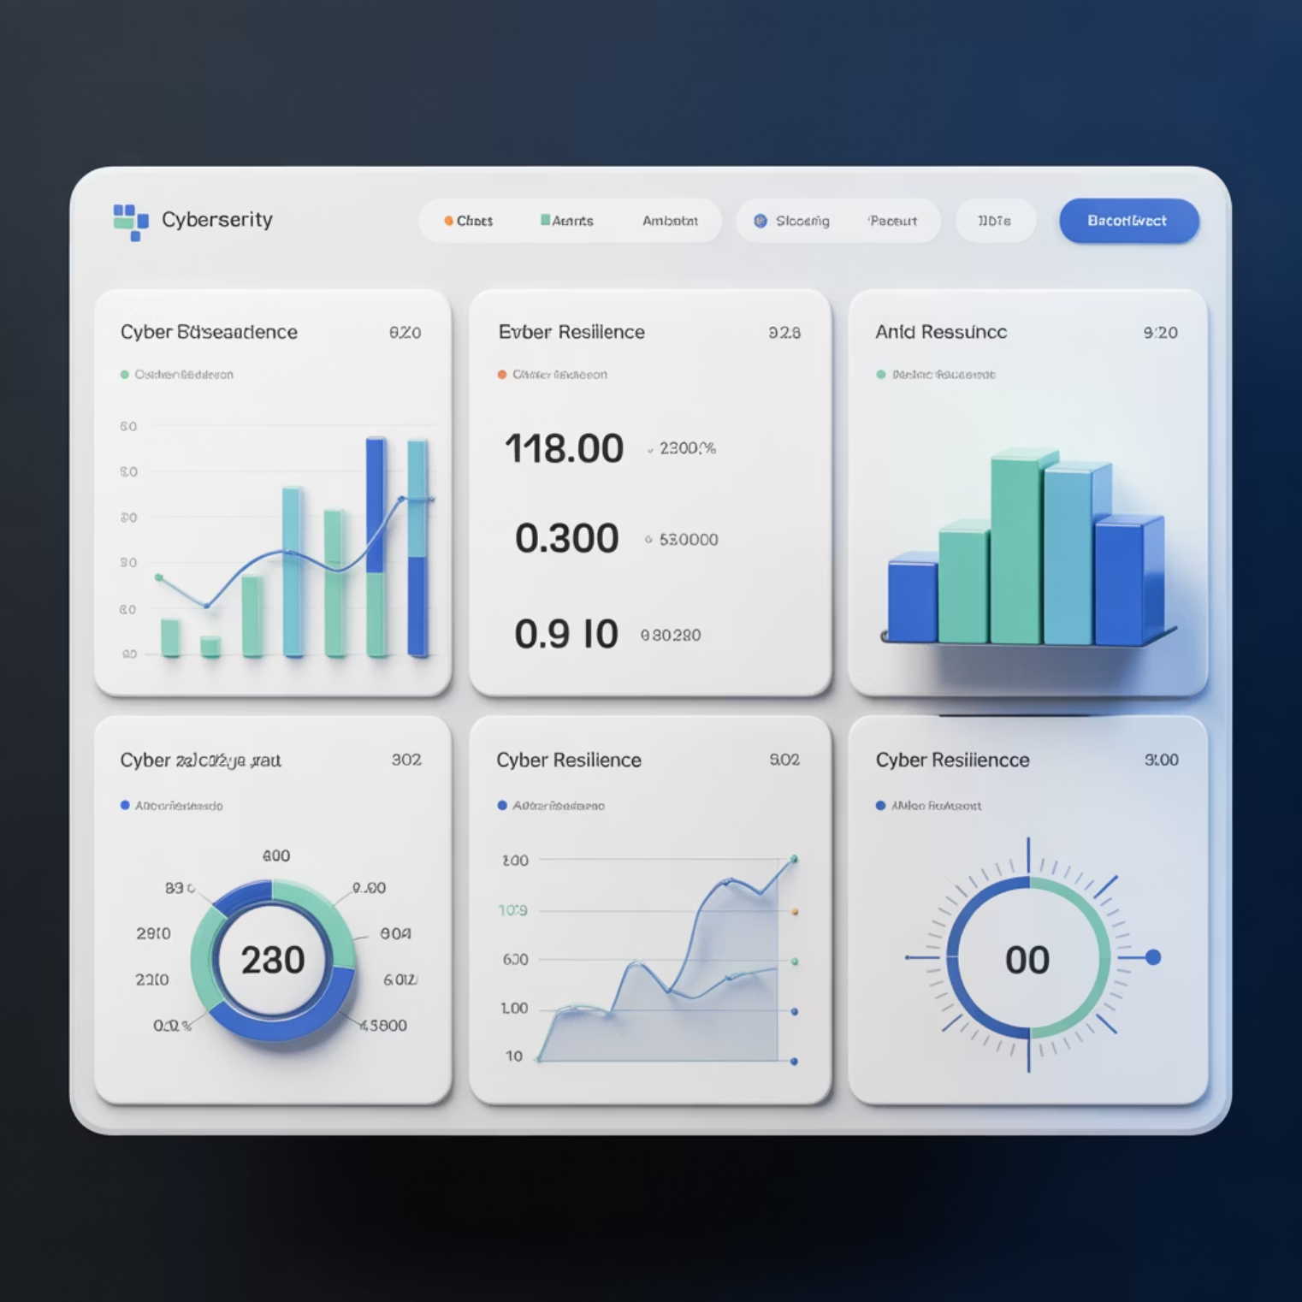
Measuring Cyber Resilience Maturity
Comprehensive measurement programs utilize quantitative metrics and qualitative assessments to evaluate cyber resilience effectiveness and drive continuous improvement.
15min
98%
Detection Speed
Recovery Success
Average time from initial compromise to threat identification
Percentage of systems restored within RTO objectives
4.2
12
Maturity Score
Test Frequency
Additional indicators include mean time to recovery (MTTR), business impact duration, stakeholder communication effectiveness, and continuous improvement implementation rates.
Framework alignment assessment on 5-point scale
Number of resilience exercises conducted annually
Notes:
Measure detection speed
Track recovery performance
Evaluate maturity alignment
Monitor testing frequency
Use MTTR and impact duration Example: Team improves response after tracking metrics. Cyber example: SOC reduces detection time quarterly.

Slide 31

Summary and Key Takeaways
Integrated Approach: Cyber resilience successfully combines security, recovery, and continuity capabilities into unified organizational strength
Framework Guidance: Standards like NIST CSF 2.0, ISO, and DRI provide structured approaches valuable for any type of organization for developing maturity
Continuous Validation: Regular testing and comprehensive metrics ensure readiness while driving systematic improvement initiatives
Leadership Commitment: Executive governance and oversight treat cybersecurity as major enterprise risk requiring dedicated attention
Strategic Value: Proactive cyber resilience transforms risk management into competitive advantage and stakeholder confidence
Remember: Cyber resilience creates sustainable organizational strength through integrated preparation, response, and recovery capabilities.
Notes:
Integrates cybersecurity and continuity
Frameworks guide comprehensive programs
Testing ensures real-world readiness
Leadership drives governance maturity
Resilience strengthens competitiveness Example: Business remains operational during cyber disruption. Cyber example: Recovery teams restore systems quickly after attack.

Slide 32
Lab 1 Time
1 Hour
Notes:
https://www.ncsc.gov.uk/static-assets/documents/PwnedPasswordsTop100k.txt

Slide 33
BREAK TIME
Be back in 15 mins.
Notes:
https://www.ncsc.gov.uk/static-assets/documents/PwnedPasswordsTop100k.txt

Slide 34
Lab 2 Time
1 Hour
Notes:
https://www.ncsc.gov.uk/static-assets/documents/PwnedPasswordsTop100k.txt

Slide 35
Kahootz & Quiz Time
Notes:
https://www.ncsc.gov.uk/static-assets/documents/PwnedPasswordsTop100k.txt

